Slide 1

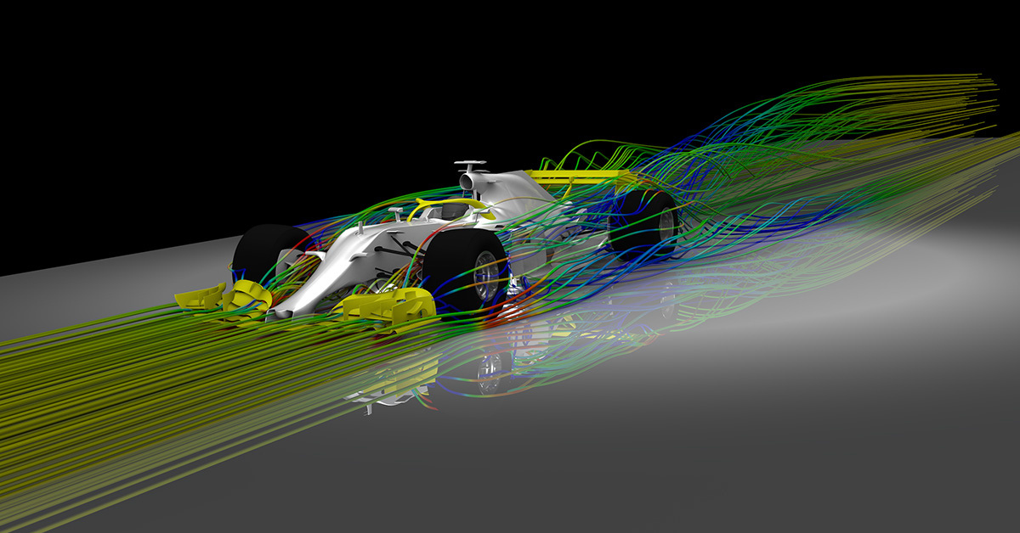
CFD
AN OVERVIEW OF VOF METHOD IN COMPUTATIONAL FLUID DYNAMICS
Presented by :
Dharmansh Vyas
Arnav Maitreya
Jahnvi Soni

Slide 2

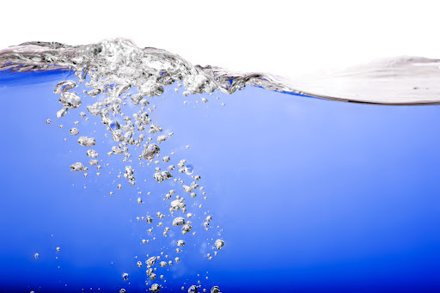
MULTIPHASE FLOW
In fluid mechanics, multiphase flow is the simultaneous flow of materials with two or more thermodynamic phases.
Method to solve
1. Volume of Fluid (VOF) Method
VOF is used to track the interface between immiscible fluids by solving a transport equation for the volume fraction of one of the fluids.
2. Eulerian-Eulerian Model
Treats each phase as an interpenetrating continuum, solving separate sets of conservation equations (mass, momentum, and energy) for each phase.
3. Eulerian-Lagrangian Model
Models the continuous phase using Eulerian framework and the dispersed phase using Lagrangian framework, tracking individual particles or droplets.
There are other ways too to solve multiphase flow

Slide 3
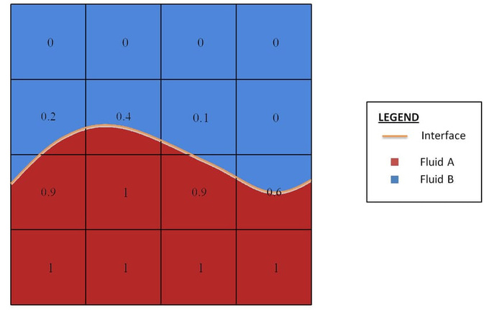
Definition: The Volume of Flow Method (VOF) is a numerical technique used in CFD to track and locate the free surface (or interface) between two immiscible fluids.
Principles: VOF is based on the concept of a fractional volume of fluid (vof) within each computational cell.
Difference: Unlike other methods like Finite Volume Method (FVM) or Finite Element Method (FEM), VOF focuses specifically on capturing the dynamics of the interface between fluids.
The VOF method utilizes the transport equation to handle the distribution and movement of the fluid phases. Here’s a detailed explanation of how the transport equation is related to the VOF method:
The VOF method uses a fractional volume function, F, to represent the volume fraction of one of the fluids within each computational cell. The value of F ranges from 0 to 1, where:
F=0: The cell is entirely filled with the second fluid.
F=1: The cell is entirely filled with the first fluid.
0<F<1: The cell contains the interface between the two fluids.

Slide 4
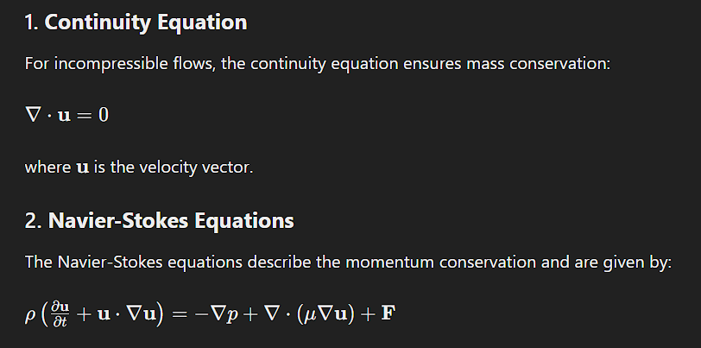

Slide 5
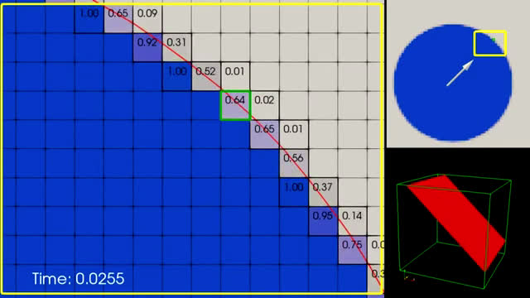

Slide 6
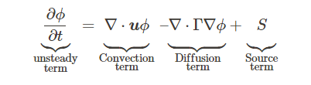
Transport Equation
Convective term gives us idea that how the scalar is changing by the flow of the fluid.
Diffusion term tell us ,how the scalar diffuses in the fluid.
The source term, represents the amount of the scalar quantity created or destroyed inside the control volume.
Unsteady term represents the change of scalar w.r.t time.

Slide 7
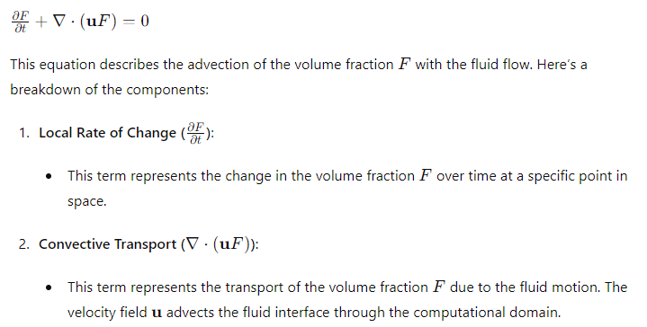
Transport Equation in VOF Method

Slide 8
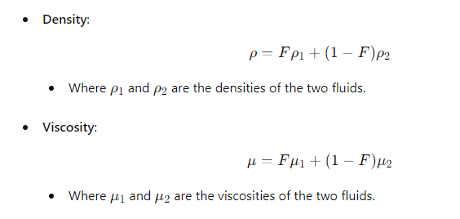
The physical properties (e.g., density ρ and viscosity μ) of the fluid mixture are computed as weighted averages based on the volume fraction F:

Slide 9
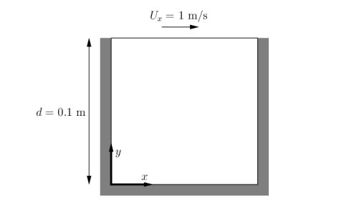
Laminar Flow
Problem -1 (Lid-Driven Cavity)
the flow will be assumed laminar and will be solved on a uniform mesh using the icoFoam solver for laminar, isothermal, incompressible flow.

Slide 10
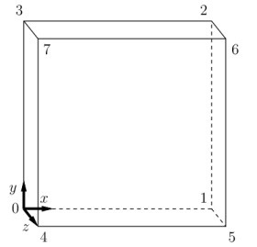
Computational Domain
movingWall -(wall)
(3 7 6 2)
fixedWalls -(Wall)
(0 4 7 3)
(2 6 5 1)
(1 5 4 0)
frontAndBack-(Empty)
(0 3 2 1)
(4 5 6 7)

Slide 11
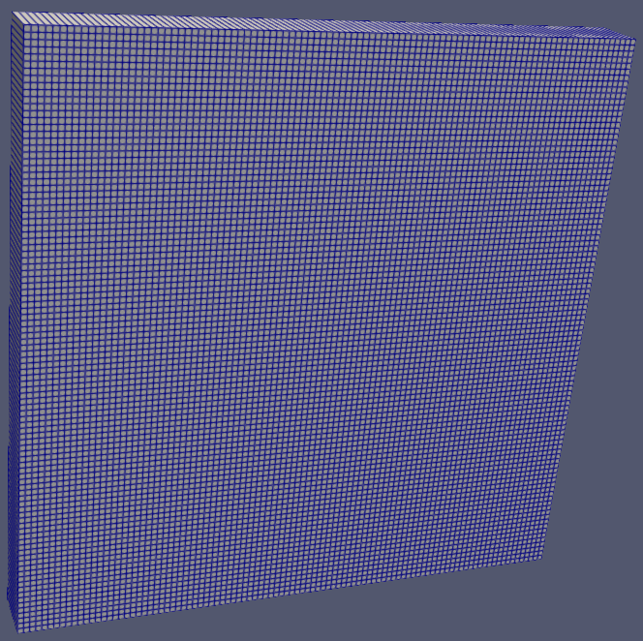
Type of mesh
The computational mesh is a structured, uniform, rectangular grid.
The grid is discretized into a finite number of cells. The domain is divided into 100 cells along the x-axis and 100 cells along the y-axis with only 1 cell in z- direction.
100 x 100
blocks
(
hex (0 1 2 3 4 5 6 7) (100 100 1) simpleGrading (1 1 1)
);

Slide 12
Boundary and initial Conditions
Pressue
Velocity
movingWall -(wall)
Zero Gradient
fixedWalls -(Wall)
Zero Gradient
frontAndBack-(Empty)
empty
INFERENCE- there is no pressure difference along thier length
movingWall -(wall)
fixedValue (1 0 0)
INFERENCE- the velocity field have value of 1 in x direction
fixedWalls -(Wall)
no Slip
INFERENCE- The velocity of the fluid in contact with the wall is zero.
frontAndBack-(Empty)
empty
movingWall -(wall)
(3 7 6 2)
fixedWalls -(Wall)
(0 4 7 3)
(2 6 5 1)
(1 5 4 0)
frontAndBack-(Empty)
(0 3 2 1)
(4 5 6 7)
internalField uniform (0 0 0);
INFERENCE- Initially, the velocity inside the domain is zero.

Slide 13
Result
1. Velocity Field:
Formation of a primary vortex due to moving lid and secondary vortices near stationaly corners.
2. Pressure Field :
Higher pressure at the lower right corner and lower pressure at the upper left corner.
3. Streamlines :
Visualization of flow paths within the cavity . Clear indication of vortex structure.

Slide 14
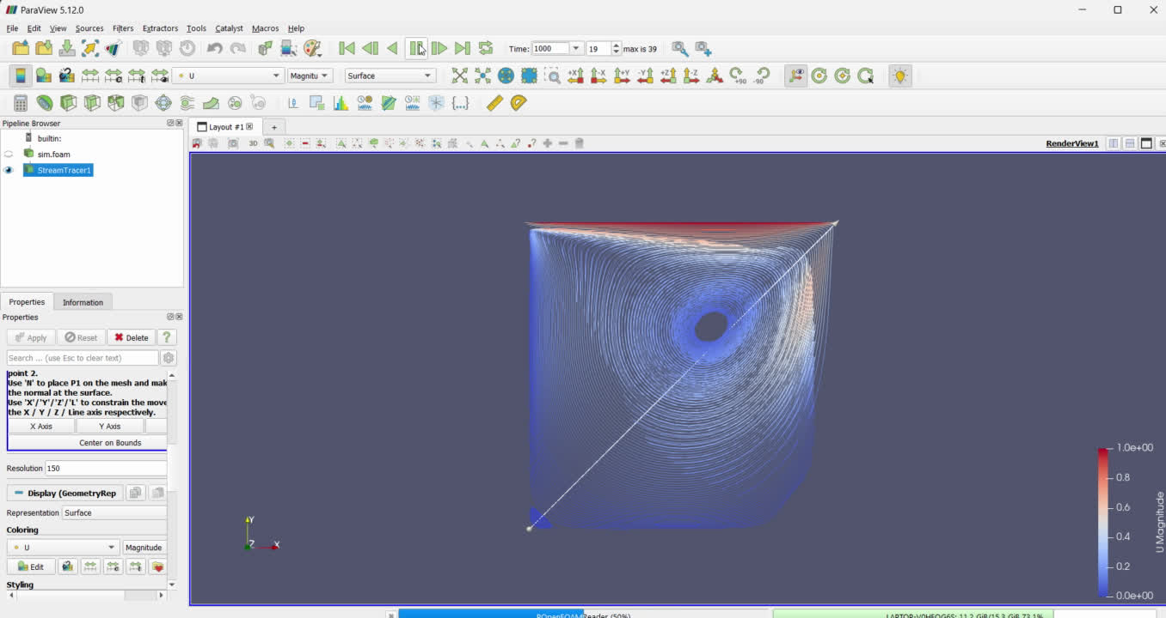
Result

Slide 15

Laminar Flow
Problem -2 (Skewed Lid-Driven Skew Cavity)
the flow will be assumed laminar and will be solved on a uniform mesh using the icoFoam solver for laminar, isothermal, incompressible flow.

Slide 16
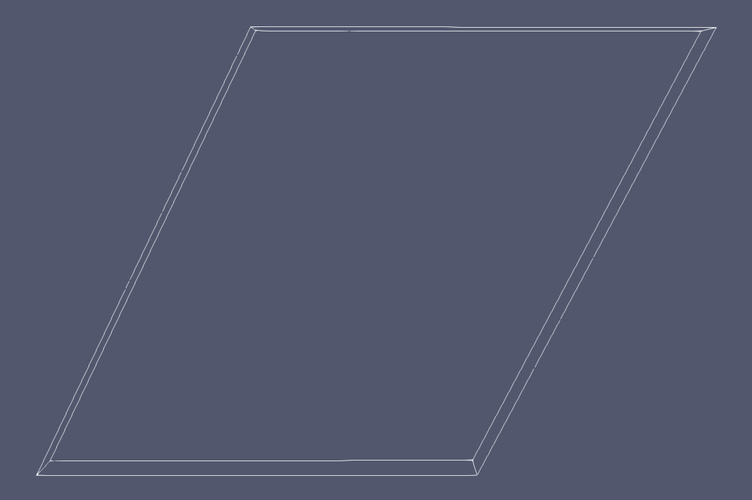
Computational Domain
movingWall -(wall)
(3 7 6 2)
fixedWalls -(Wall)
(0 4 7 3)
(2 6 5 1)
(1 5 4 0)
frontAndBack-(Empty)
(0 3 2 1)
(4 5 6 7)

Slide 17
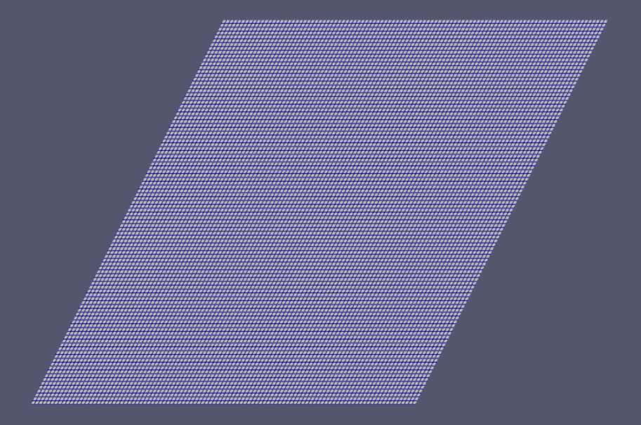
Type of mesh
The computational mesh is a structured, uniform, skewed grid at 60 degrees.
The grid is discretized into a finite number of cells. The domain is divided into 100 cells along the x-axis and 100 cells along the y-axis with only 1 cell in z- direction.
100 x 100
blocks
(
hex (0 1 2 3 4 5 6 7) (100 100 1) simpleGrading (1 1 1)
);

Slide 18
Boundary and initial Conditions
Pressue
Velocity
movingWall -(wall)
Zero Gradient
fixedWalls -(Wall)
Zero Gradient
frontAndBack-(Empty)
empty
INFERENCE- there is no pressure difference along thier length
movingWall -(wall)
fixedValue (1 0 0)
INFERENCE- the velocity field have value of 1 in x direction
fixedWalls -(Wall)
no Slip
INFERENCE- The velocity of the fluid in contact with the wall is zero.
frontAndBack-(Empty)
empty
movingWall -(wall)
(3 7 6 2)
fixedWalls -(Wall)
(0 4 7 3)
(2 6 5 1)
(1 5 4 0)
frontAndBack-(Empty)
(0 3 2 1)
(4 5 6 7)
internalField uniform (0 0 0);
INFERENCE- Initially, the velocity inside the domain is zero.

Slide 19
Result
1. Velocity Field:
Skewed primary vortex, possible secondary vortices near corners, and altered velocity vectors and contours.
2. Pressure Field :
Adjusted high-pressure regions and shifted zones influenced by 60-degree skewness.
3. Streamlines :
Skewed flow paths reflecting the inclination. Clear depiction of skewed vortex structures.

Slide 20
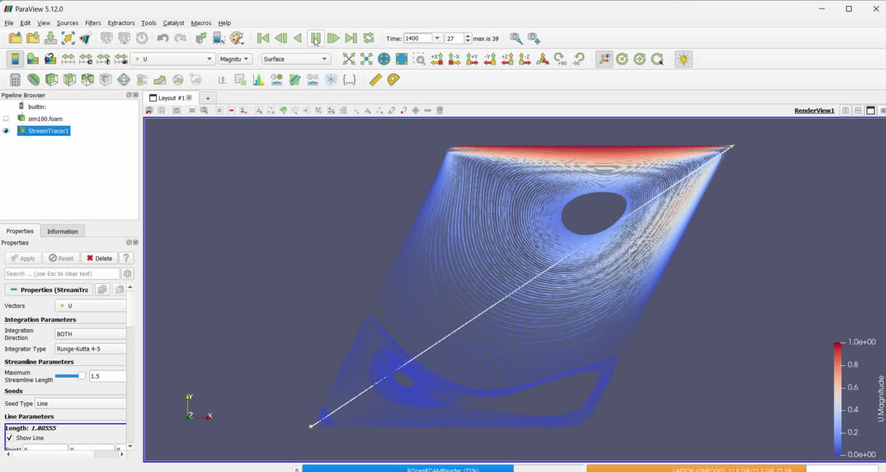
Result

Slide 21

Laminar Flow
Problem -3 (elbow)
The elbow tutorial in OpenFOAM provides a comprehensive example of setting up, running, and post-processing a steady-state incompressible turbulent flow simulation in a curved pipe.

Slide 22
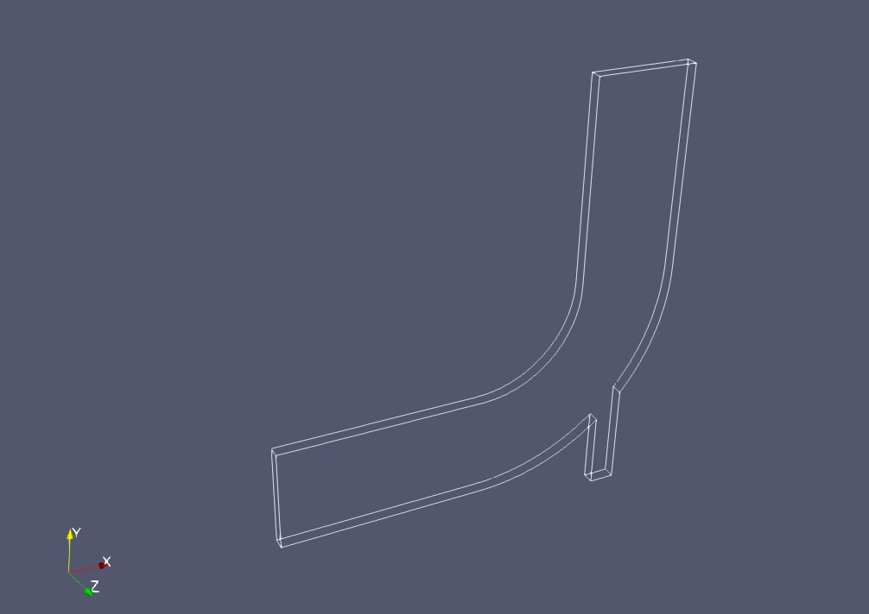
Computational Domain
2
1
3
Inlet 1
( 9 10 11 12 )
Inlet 2
(5 6 7 8 )
Outlet
(1 2 3 4 )
Fixed wall Upper
(10 1 4 11)
Fixed wall Lower
(9 2 3 12)
4
10
11
5
6
7
8
9
12

Slide 23
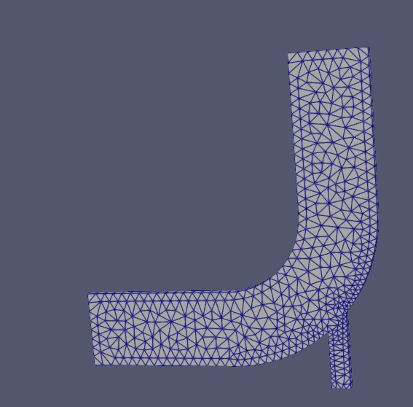
Type of mesh
The computational mesh is an unstructured, non-uniform, triangular mesh.
With inlets having nFaces 8 and 4, outlet with 8 and walls having 34 and 100.
Mesh is generated using Fluent with .msh extension and then converted in openFoam format with “fluentToFoam” command.

Slide 24
Boundary and initial Conditions
Pressue
Velocity
Inlet 1
Zero Gradient
Inlet 2
Zero Gradient
Fixed wall Upper
Zero Gradient
Fixed wall Lower
Zero Gradient
INFERENCE- there is no pressure difference along thier length
frontAndBack-(Empty)
empty
outlet
Fixed Value
INFERENCE- the pressure at the outlet of the computational domain is set to a constant value, which is crucial for driving the flow through the elbow.
Inlet 1
fixed Value - uniform(1 0 0)
INFERENCE- the velocity filed at inlet 2 with 1m/s in x direction
Inlet 2
fixed Value - uniform(0 3 0)
INFERENCE- the velocity filed at inlet 1 with 3m/s in y direction
Fixed wall Upper
no slip
Fixed wall Lower
no slip
frontAndBack-(Empty)
empty
outlet
Zero Gradient
Inlet 1
( 9 10 11 12 )
Inlet 2
(5 6 7 8 )
Outlet
(1 2 3 4 )
Fixed wall Upper
(10 1 4 11)
Fixed wall Lower
(9 2 3 12)

Slide 25
Result
Velocity Fields :
Inlets show smooth and uniform velocity due to zeroGradient, ensuring consistent flow entry.
2. Pressure Fields :
Outlets maintain constant pressure via fixedValue, ensuring controlled pressure.
Pressure drop along the elbow, typical for fluid flow through curves.

Slide 26
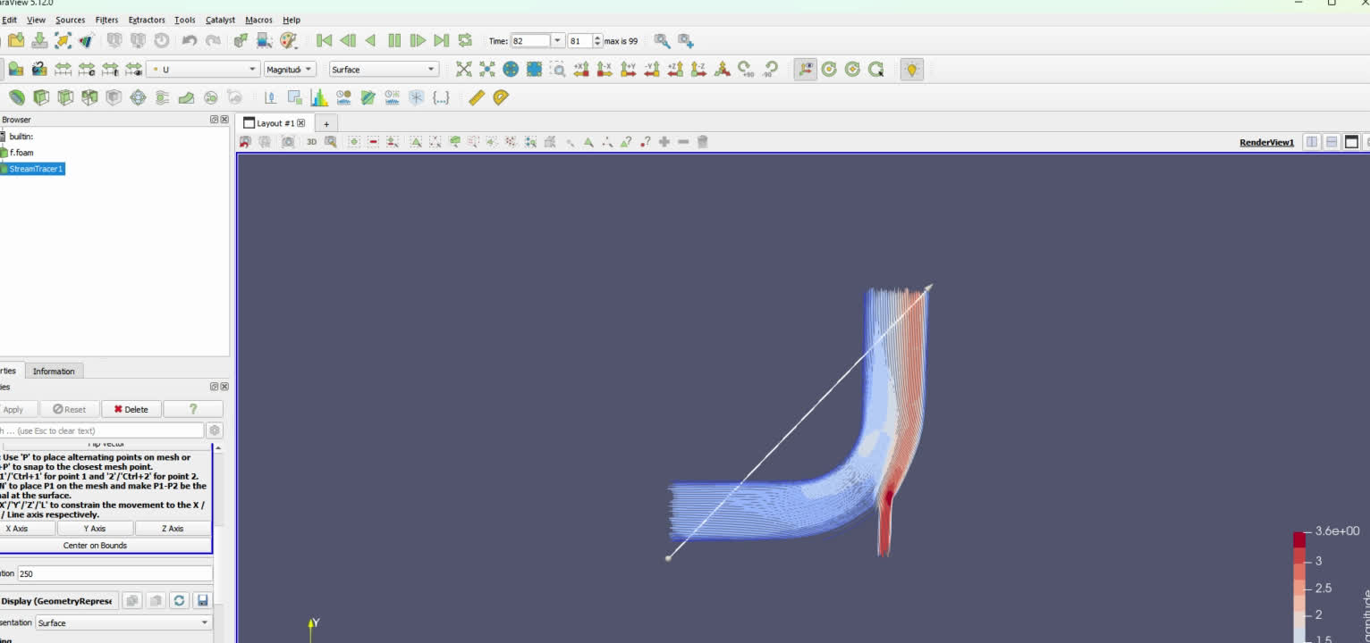
Result

Slide 27
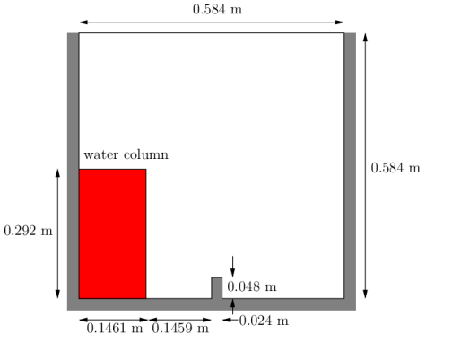
VOF METHOD
Problem -4 (Dam-break)
The test setup consists of a column of water at rest located behind a membrane on the left side of a tank. At time t = 0 s , the membrane is removed and the column of water collapses. During the collapse, the water impacts an obstacle at the bottom of the tank and creates a complicated flow structure, including several captured pockets of air.
Our goal is to study that complicated structure.

Slide 28
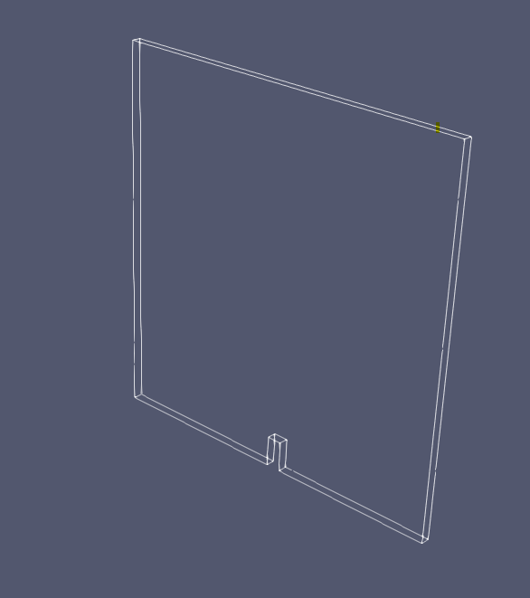
Computational Domain
left Wall
(0 12 16 4)
(4 16 20 8)
right Wall
(7 19 15 3)
(11 23 19 7)
lower Wall
(0 1 13 12)
(1 5 17 13)
(5 6 18 17)
(2 14 18 6)
(2 3 15 14)
atmosphere
(8 20 21 9)
(9 21 22 10)
(10 22 23 11)

Slide 29
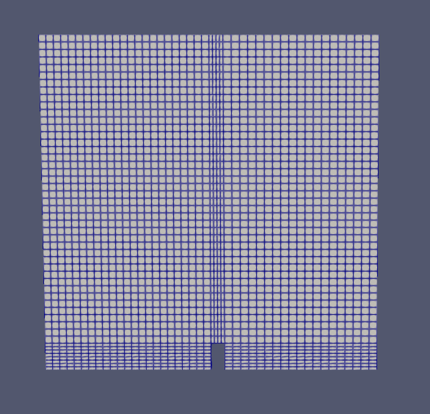
Type of mesh
The computational mesh is structured,regular ,rectangular grids.
The Domain is divided into 5 blocks each having finite no. of cells.
blocks
(
hex (0 1 5 4 12 13 17 16) (23 8 1) simpleGrading (1 1 1)
hex (2 3 7 6 14 15 19 18) (19 8 1) simpleGrading (1 1 1)
hex (4 5 9 8 16 17 21 20) (23 42 1) simpleGrading (1 1 1)
hex (5 6 10 9 17 18 22 21) (4 42 1) simpleGrading (1 1 1)
hex (6 7 11 10 18 19 23 22) (19 42 1) simpleGrading (1 1 1)
);

Slide 30
Boundary and initial Conditions
Pressue
Velocity
alpha.water
leftWall
fixedFluxPressure - uniform 0
rightWall
fixedFluxPressure - uniform 0
lowerWall
fixedFluxPressure - uniform 0
INFERENCE- The flux is specified at the boundary, and pressure is adjusted to maintain this flux.
atmosphere
totalPressure - uniform 0
defaultFaces
empty
leftWall
noSlip
rightWall
noslip
lowerWall
noSlip
INFERENCE- velocity at wall is 0
atmosphere
pressureInletOutletVelocit
- uniform (0 0 0)
iNFERENCE-
defaultFaces
empty
internal Field uniform 0
leftWall
zeroGradient
rightWall
zeroGradient
lowerWall
zeroGradient
atmosphere
inletOutlet
inlet - uniform 0
iNFERENCE-
defaultFaces
empty

Slide 31
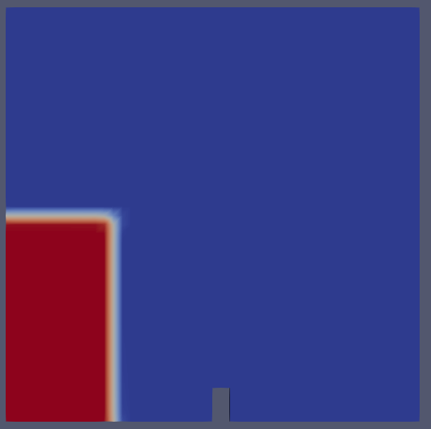
Initial Set Fields :
value of volume fraction(f) or alpha, is set by taking primary fluid as water and secondary fluid as air.
f = 1 (water) f = 0 (air)
defaultFieldValues
(
volScalarFieldValue alpha.water 0
);
// domain is field with air as f = 0, region is shown by blue.
regions
( boxToCell
{ box (0 0 -1) (0.1461 0.292 1);
fieldValues
( volScalarFieldValue alpha.water 1
); } );
// columne of water is at initial condition is set in region having f =1, region shown by red color.

Slide 32
Result
1.Early Collapse Phase:
Water spreads out, forming a complex interface.
High-velocity jet forms, leading to horizontal spread.
2.Impact on Walls:
Jet impacts the opposite wall, causing splashes and secondary flows.
Air pockets and mixing regions form near the impact site.

Slide 33
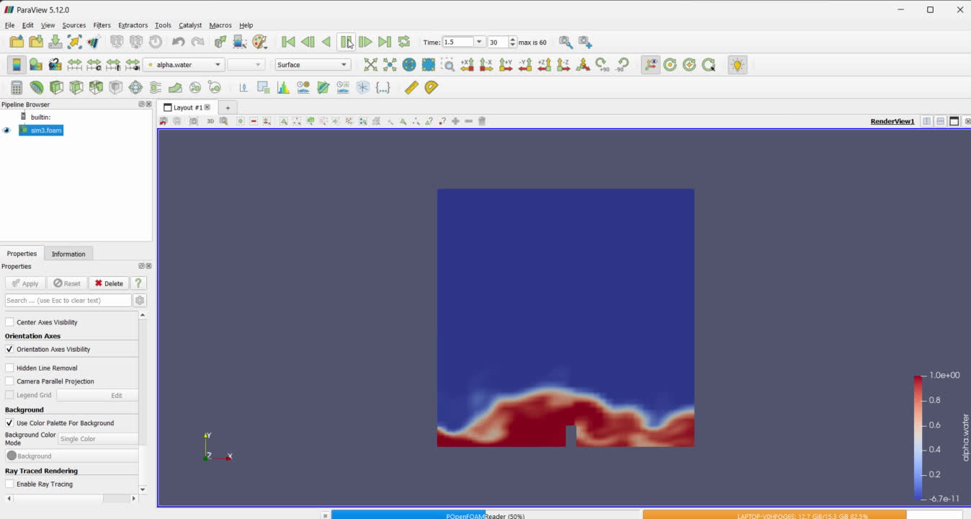
Result

Slide 34
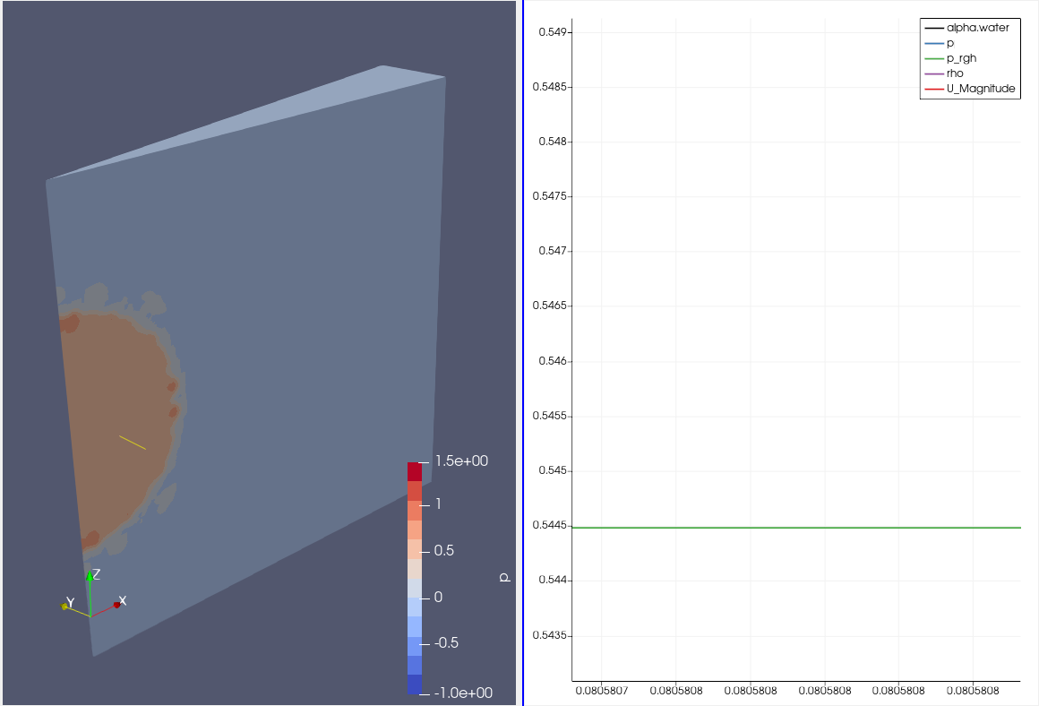
Pressure inside
water drop
=0.5445 N/m^2

Slide 35
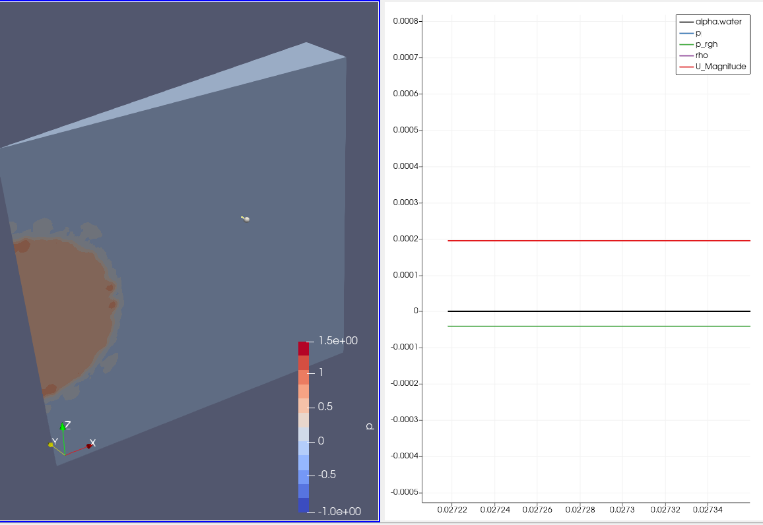
Pressure outside
water drop
= 0(approx)

Slide 36
theoretically pressure difference =
2*Sigma/r
=2*(0.072)*(0.25)
=0.576 N/m^2
Computational result pressure difference =
=0.5445 N/m^2
Error = 0.0315
Error % = 3.15%
r=0.25m

